Slide 1

Fudge Corporation Ltd.
Amit Jadhav
Manan Dedhia
Simaant Patil
Shripad Laddha

Slide 2

Table Of Contents
About
Project Charter
Business Processes
Star Schema
Visualization
Insights
Recommendation
Summary

Slide 3

About
FudgeMart - It is a online retailer and consists a database variety of products, customers and vendors and provides shipping information of these products to its customers.
FudgeFlix - Fudgeflix is a online DVD by mail and video service for its customers, similar to Netflix, and contains details like the accounts, subscriptions and video titles.
Fudge Corporation Ltd. - It is a merger between Fudgemart and Fudgeflix which provides its customers the benefits of both the services by serving as a single platform.

Slide 4

Project Charter
Mission: To develop an Order Fulfillment business case for Fudge Corporation Ltd (FCL).
Business Case: To streamline the business process for Order Fulfillment for the merger of Fudgemart and Fudgeflix for ensuring customer satisfaction, that is less lag in days
Stakeholders: Marketing, Sales, Business Analytics and Senior Executives
Team:
Manan Dedhia: Project Manager Amit Jadhav: BI Analyst
Shripad Laddha: BI Analyst Simaant Patil: BI Analyst

Slide 5
Business Processes
Order Fulfillment
We calculate and compare lag days for both FudgeFlix and FudgeMart. Based on the analysis we give the recommendations for the same.
(Account title, Account, titles) (Customers, Products, Order Details, Orders, ShipVia, Vendors, Department Lookup).
Other Identified Business Processes:
Product Ratings
Product Sales
Title Delivery
Customer Satisfaction

Slide 6


Slide 7
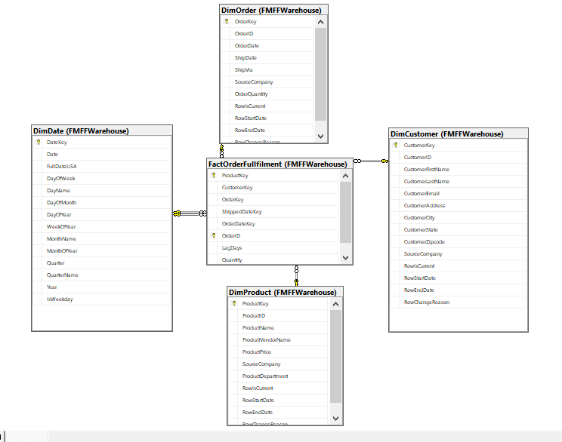
Star Schema

Slide 8
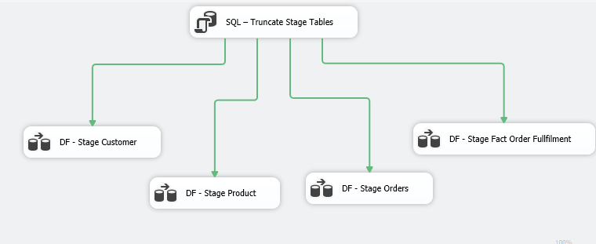
ETL Process
Stage Import

Slide 9
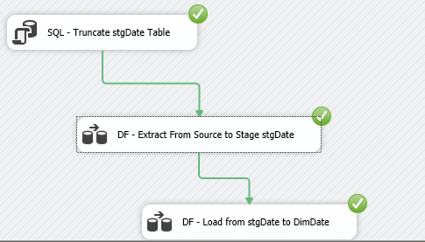
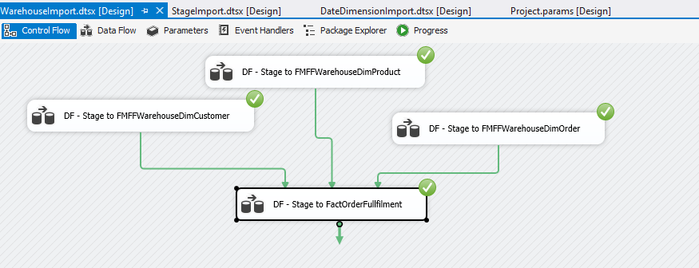
ETL Process
Warehouse Import
Date Import

Slide 10

Visualization &
Business Intelligence

Slide 11
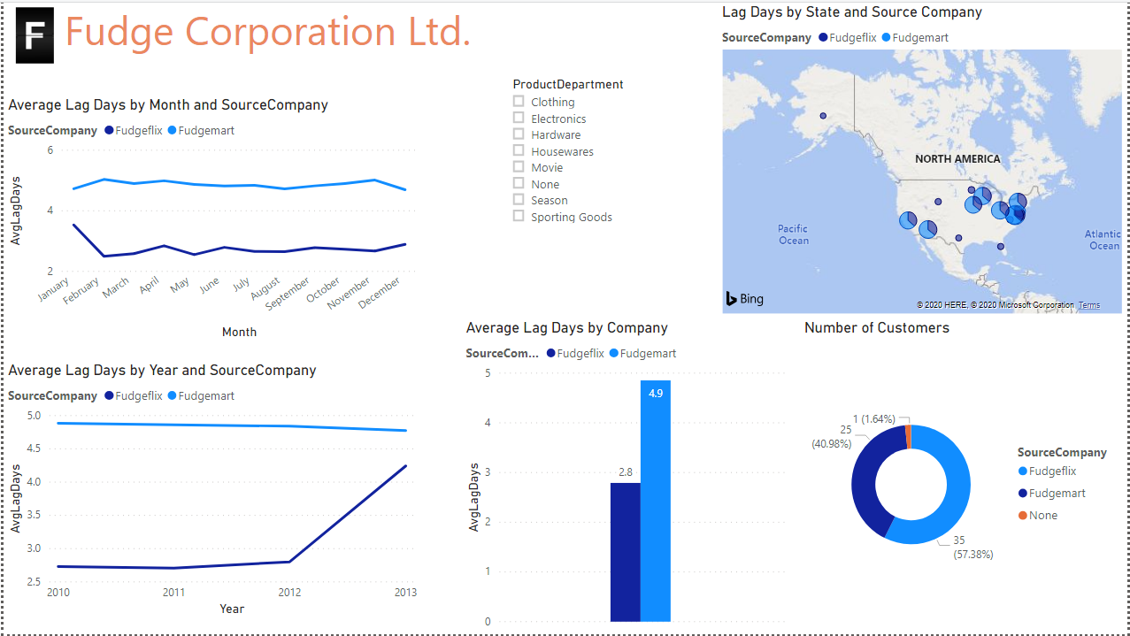

Slide 12
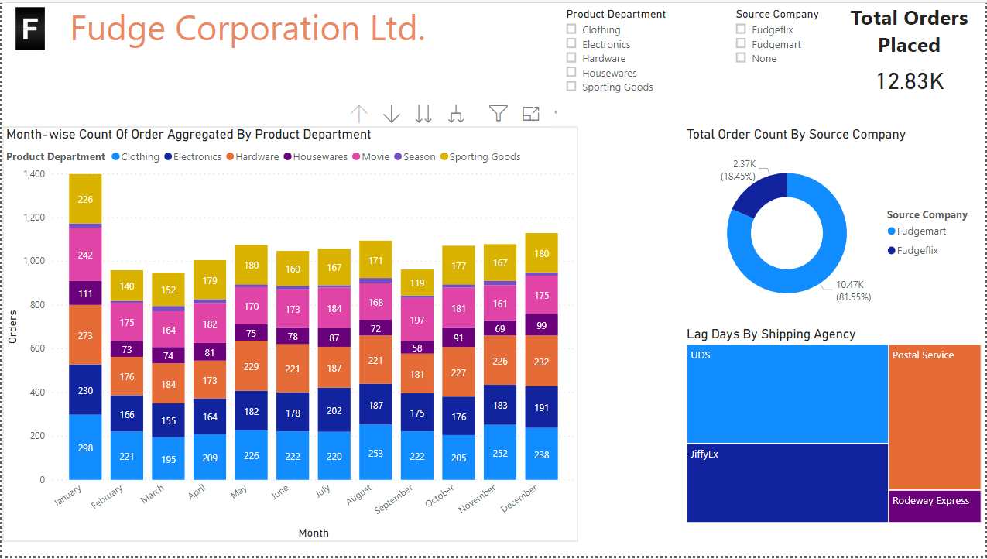

Slide 13

Insights and Data
Amongst the FudgeMart company, Rodeway Express has the minimum lag days.
UDS has the maximum Lag days.
Average number of lag days for Fudge Mart is greater than FudgeFlix.
Average lag days for FudgeFlix spiked from 2012 to 2013( this is because we have the data only till Feb 2013).

Slide 14

Insights and Data
There are total 7,239 unique products in both FudgeFlix and FudgeMart.
Amount of products in FudgeMart is 53 and in FudgeFlix is 7,186.
FudgeFlix started from 2009.
FudgeMart started from 2010.
The number of customers in Fudgemart is 25 and FudgeFlix is 35.

Slide 15

Recommendations
The average lag days in both the companies is higher during ending months of year, we recommend FCL to divert more resources for faster delivery.
Major chunk of customers are in Arizona, California, New York, Wisconsin, District of Columbia, hence orders from these areas must be given priority.
DC has the highest lag days for FudgeMart products and Minnesota has the highest lag days for FudgeFlix products hence the delivery should be optimized in these areas.

Slide 16
Recommendations
We recommend that Fudge Corporation (FCL) ships most of their products via Rodeway Express as they have the fastest service and alter other shipper’s orders.
We recommend that FCL allocate higher resources to system during month of January as we see a spike in orders during that month.
We noticed that a major chunk of FCL customers belong to East coast and West coast. We suggest FCL bolsters marketing campaigns to gain market from central America region.

Slide 17
Summary
This project was focused on merging of two companies, FudgeFlix and FudgeMart.
Our main objective was to analyze Order Fulfillment business process.
For our ETL process, we utilized SSIS for our integration process and we used SSAS for our analysis.
To generate actionable insights, we created visualizations using Microsoft Power BI.
Based on our analysis, we provided recommendations to improve the efficiency of the Order Fulfillment business case.

Slide 18
Live Demo

Slide 19
Thank you!
Any Questions?

